Slide 1

Introduction to Noncredit Education
Rory Johnson, Dean, Career, Energy, Entrepreneurship, Skilled Trades & Technology
Amber Cavanaugh, Director, Community Workforce Development
Notes:
Rory & Amber – Introduce yourself
Rory – The purpose of this presentation is meant to be the beginning of a conversation about non-credit education...

Slide 2

Agenda
What is Noncredit education?
Why is Noncredit education important?
How is Noncredit different from “for-credit” and Not-for-credit?
What is the role of faculty in Noncredit education?
Where can faculty learn more about Noncredit education?
Notes:
Amber

Slide 3
What is Noncredit Education?
Notes:
Amber

Slide 4
Noncredit Education
Noncredit instruction includes an array of no-cost courses that help students reach their personal, academic and professional goals.
Ten categories of noncredit courses are eligible for state apportionment in accordance with California Education Code sections 84757(a) and 84760.5 and California Code Regulations title 5, section 58160.
Career Development and College Preparation (CDCP) approved programs receive enhanced apportionment in accordance with California Education Code, Section 84760.5
California Community Colleges, Chancellor’s Office, Noncredit Curriculum and Instructional Programs
Notes:
Amber

Slide 5
10 Noncredit Education Categories & 1 Support Service
5 CCR § 58160. State Apportionment for Noncredit Courses, Noncredit Classes, and Support Services.
(a) The following is an exclusive list of noncredit courses, noncredit classes, and support services that are eligible for state apportionment funding:
  (1) Parenting, including parent cooperative preschools, classes in child growth and development and parent-child relationships.
  (2) Elementary and secondary foundational skills and other courses and classes such as pretransfer-level academic courses or classes in reading, mathematics, and language arts.
  (3) English as a second language, including vocational English as a second language.
  (4) Workforce preparation classes in the foundational skills of speaking, listening, reading, writing, mathematics, decision-making, and problem-solving, and other classes required for preparation to participate in job-specific technical training.
  (5) Courses in citizenship for immigrants.
  (6) Education programs for persons with substantial disabilities.
  (7) Short-term vocational programs with high employment potential.
  (8) Education programs for older adults.
  (9) Education programs for home economics.
  (10) Health and safety education.
  (11) Supervised tutoring for foundational skills and for degree-applicable and transfer-level courses.
*Highlights are CDCP eligible subjects
California Code of Regulations
Notes:
Rory not going to read the list, draw attention to highlighted categories

Slide 6
Why is Noncredit Education Important?
Notes:
Rory – so, let's talk about why we should be considering expanding non-credit offerings...

Slide 7
Student Centered Funding Formula (SCFF) Rates
Category | 2024-25 Rates | 2025-26 Rates
FTES – Credit | $5,294.42 | $5,416.20
FTES – CDCP | $7,424.53 | $7,595.29
FTES – Noncredit | $4,464.58 | $4,567.26
Noncredit courses tied to CDCP Programs receive enhanced FTES apportionment.
2025-26 Advance Apportionment Memo: July 18, 2025
Notes:
Amber

Slide 8
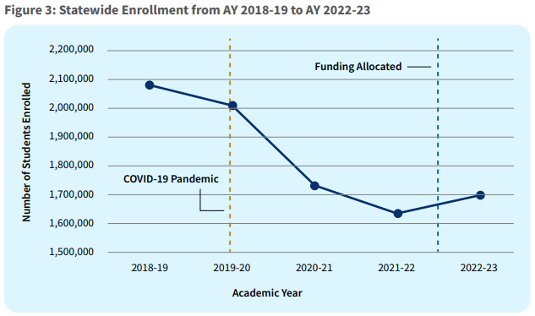
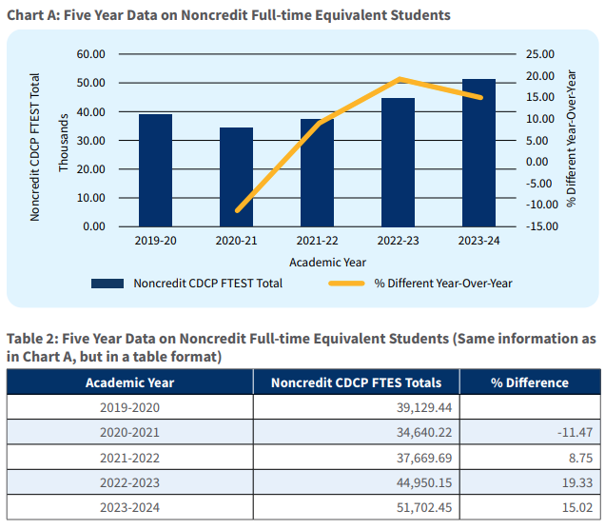
California Community College Statewide Enrollment Landscape
Combined Credit and Noncredit Enrollment
Noncredit, CDCP Enrollment
Figure 3: Retention and Enrollment Efforts, 2025 Report
Chart A: Career Development and College Preparation, 2019-24 Report
Notes:
Rory
In general, CCC enrollment is declining statewide.
Noncredit enrollment is rising statewide. This signifies demand, thus opportunity

Slide 9
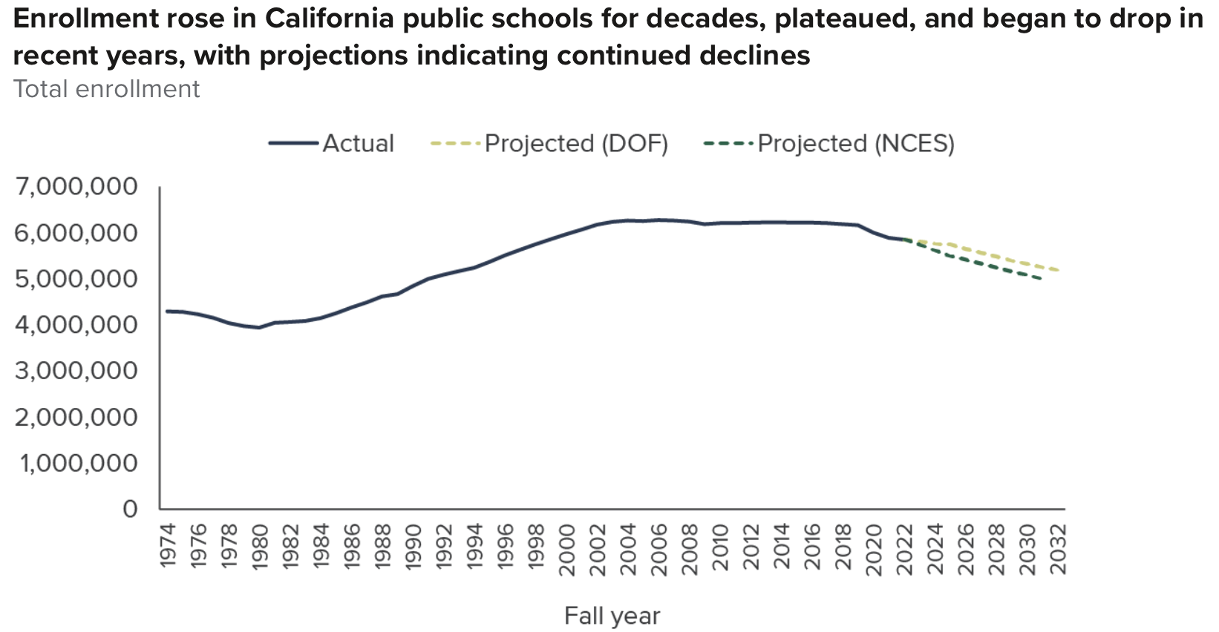
California K–12 Public School Statewide Enrollment Landscape
Since 2019, enrollment in California public schools has declined in 72% of K-12 Districts.
Lower K-12 enrollment means lower expected college enrollment.
However, Noncredit programs can help mitigate this loss.
Factors and Future Projections for K–12 Declining Enrollment, Public Policy Institute of California
Unpacking California’s Continued School Enrollment Decline
Notes:
Rory - approaching a projected enrollment cliff of freshman college students, to avoid enrollment declines we need to expand opportunities for "less traditional" groups

Slide 10
Further Benefits of Noncredit
Educational Equity
  Reduces barriers to college
  Increases access for non-traditional students
  Zero cost tuition
  AB540: Noncredit attendance hours count towards eligibility for reduced tuition
  Repeatability
Fiscal Sustainability
  Enhanced apportionment for CDCP
  Mitigation of forecasted statewide reductions in enrollment
Vision 2030, Educational Master Plan, CR President’s goals, CR Board of Trustees goals, VP of Instruction & Student Development goals and the Academic Senate goals.
Notes:
Amber
Nontraditional students: English language learners, work-force reentry, industry lay-offs, parents
Low stakes way for people to get started in college; grades do not impact future financial aid, no tuition cost, financial aid not necessary, can repeat as many times as they want.
AB540: noncredit courses apply towards eligibility. Requirements: High school diploma + 3 years of attendance in either high school, adult school, college, or noncredit. 420 hours of noncredit= 1 year.
Vision 2030 Strategic Direction 2- equitable workforce and economic development
EMP Initiative #2: Expand and Prioritize Offerings that Prepare Students for Living-Wage Jobs
EMP Initiative #3: Create a More Nimble and Adaptable Institution
EMP Initiative #6: Increase Commitment to Diversity, Equity and Inclusion
President's Goal 2: Fiscal Stability and Health
President's Goal 3: Student access and success, retention, and completion
President's Goal 5: Innovation and Planning for the Future
President's Goal 7: CR's presence in the broader community
Board Goal 1: Fiscal Stability
Board Goal 2: Student Success and Advocacy
VP I & SD Goal 2: Fiscal Stability
VP I & SD Goal 3: Student Access Retention, Completion & Success
VP I & SD Goal 4: Innovation and Planning for the Future
VP I & SD Goal 6: Partnership & Community

Slide 11
How is Noncredit different from “For-credit” and Not-for-credit?
Notes:
Amber

Slide 12
Noncredit (Including but not limited to Adult Education)
"For-credit" (Traditional credit-bearing college courses)
No tuition cost
Generate state apportionment.
Eligible for enhanced CDCP apportionment.
Chancellor's Office curriculum approval is required.
TLU-based instructional pay.
Taught by faculty who meet min quals
Courses offering 0 college credits
Noncredit certificates awarded.
Tuition & Fees cost
Generate state apportionment.
Not eligible for enhanced CDCP apportionment.
Chancellor's Office curriculum approval
is required.
TLU-based instructional pay.
Taught by faculty who meet min quals
Courses offering 0.5 or more college credits
Certificates and Degrees awarded.
Notes:
Rory …

Slide 13
Not-for-credit (Community and Contract education)
Does not generate state apportionment.
Chancellor's Office approval for curriculum is not required.
Contracted instructional pay, not TLU-based
Taught by instructors who meet industry qualifications where needed.
Affordable not-for-credit learning opportunities, such as classes, workshops, seminars, and excursions for personal and professional enrichment.
Self-supporting at the local level and are open to all members of the community willing to pay a minimum fee or can be sponsored by outside agencies (ie: employers)
Courses offering NO COLLEGE CREDITS
Notes:
Amber
Model where courses or programs going through curriculum can be piloted through community ed.
New certifications may come up in say Auto or Fire Tech that are needed to meet industry standards and compliance and they need to be implemented more quickly than the curriculum schedule allows. Those can be implemented through community ed.

Slide 14
What is the Role of Faculty in Noncredit Education?
Curriculum development
CDCP Certificate development
Assess curriculum
Ensure curriculum meets appropriate level of academic rigor
Inform colleagues
Join future task-forces
Noncredit lens
Speak to your Deans
Engage
Notes:
Rory …

Slide 15
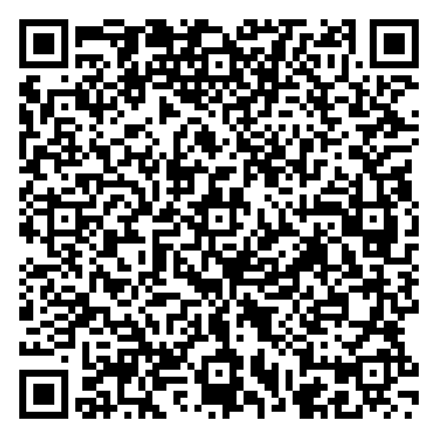
Where can faculty learn more?
Noncredit Curriculum and Instructional Programs
  Learn more about Adult Education, CDCP, and not-for-credit
California Adult Education Program
  Learn more about CAEP (formerly known as the Adult Education Block Grant)
California Adult Education Fact Sheets
  North Coast Region
  Statewide
Model Programs
Career Development and College Preparation (CDCP) 2019-24 Report
Retention and Enrollment Efforts, CCC Chancellor’s Office 2025 Report
California Code of Regulations 58160. State Apportionment for Noncredit Courses, Noncredit Classes, and Support Services
Vision 2030 Strategic Direction 2: Equitable Workforce and Economic Development
Program and Course Approval Handbook- 8th Ed.
  Part III refers to Noncredit curriculum
2025-26 Advance Apportionment Memo: July 18, 2025
Notes:
Amber
QR code for a document with live links

Slide 16
Noncredit Program Examples
Mount San Antonio Community College – Continuing Education
  School Of Continuing Education
North Orange Community College – Continuing Education
  Programs - North Orange Continuing Education
Santa Barbara City College-School of Extended Learning
  Career Skills Institute - Santa Barbara City College
CAEP (California Adult Education Program) Model Programs
  Model Program - California Adult Education Block Grant

Slide 17
Thank you!
Questions?
Notes:
Amber and Rory

