Slide 1
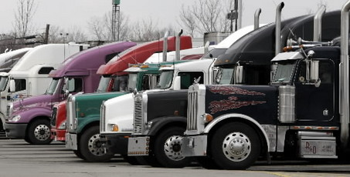

College of the Redwoods
Truck Driving
CDL Training Program

Slide 2
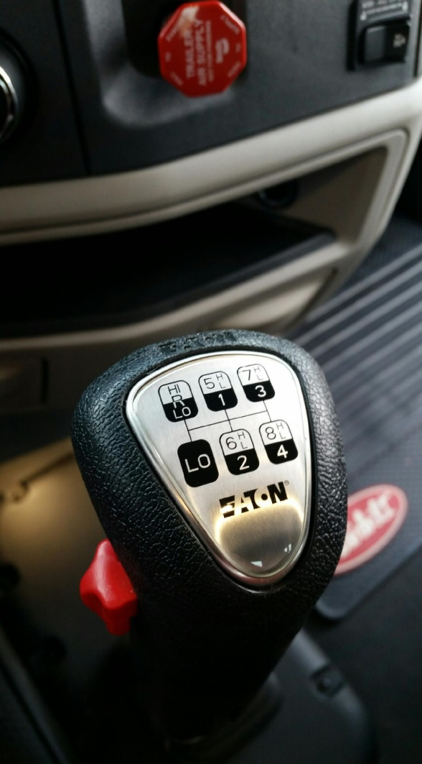
Informational Meeting Agenda
Staff / guest introductions
Program dates / location
Application Packet Requirement
Alcohol/Drug Screening
Lottery Drawing
Mandatory Orientation
Driving Test at DMV
Costs / How to pay
Questions

Slide 3
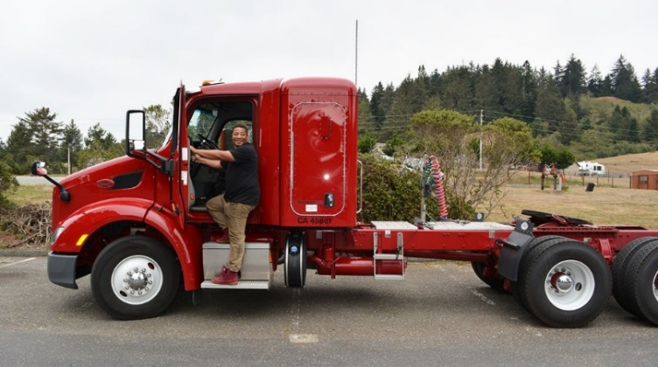
Program Schedule
April 3rd – May 1st, 2026
4-week session
Behind the Wheel Training:
Driving/Observation sessions
Monday - Friday
7:00a – 12:00p or 12:00p – 5:00p
Notes:
Folder Doc – Schedule

Slide 4
Program Location(s)
Online Theory Portion:
Entry Level Driver Training (ELDT)
Weekly lessons to complete
Truck Location
College of the Redwoods – Main Campus
7351 Tompkins Hill Road
Notes:
Pre-Class – 2 maps

Slide 5
Process Overview
Informational Meeting
Application Period
Lottery
Registration / Payment
Program begins

Slide 6
Application Packet Requirements
All Due by Monday March 23rd at 4:00pm
  Completed Truck Driving Program Application
  Current California Driver’s License
  DMV Driving Record
  Certified Medical Examiners Report
  Class A Learners Permit (3 tests)
      General Knowledge, Air Brakes and Combination Vehicles
  Negative Drug Screening – details provided by The Green Light, LLC
  Release of Information
  Signed Controlled Substance and Alcohol Policy
  Anticipated Funding Source – (If you are being sponsored, a letter from the sponsoring agency is required)
Notes:
Document – do in this order

Slide 7
Alcohol / Drug Screening Information

Slide 8
Lottery Overview
All completed applications will be entered into the drawing.
March 24th : Lottery Drawing
March 26th : Email notification will go out with assigned number.
First 4 names drawn – are accepted into the April 2026 session.
  Remaining names drawn will have “priority registration” for the next three sessions being offered.

Slide 9
Mandatory Orientation Meeting
(Numbers 1-4)
Friday, April 3rd
5:00pm-6:00pm
527 D street, Eureka CA
Room 102

Slide 10
Driving Test at DMV
Program truck is used for the driving test
Registration for the exam will occur at Orientation
Students are given 3 attempts at the driven test

Slide 11
Program Info and Costs
Online Theory Portion: Completion of all lessons is required Behind the Wheel Training:
Driving | 45-50 | hours
Observation | 45-50 | hours
DMV Warm-Up & Driving Test | 5 | hours
* CA requires min 15 hours of behind the wheel training
Costs Program Costs |  | Cost Breakdown $4500
DMV Driving Record Printout |  | $5
Class A Permit Test Fee |  | $95
Drug Screen |  | $125
DOT Physical Examination |  | $100-200
Truck Driving Program Costs (approx.) |  | $4,785 - $4,950

Slide 12
Payment & Funding Confirmation
There are several ways to pay for the program:
Pay in full: Cash, Check, Credit/Debit Card
Nelnet Payment Plan
Sponsored by an agency (some examples include)
  Department of Rehabilitation
  VA Benefits
  Native American Tribes
  Unless we have documentation in our office from a sponsoring agency, you ARE NOT considered sponsored!.
Notes:
Folder – Sponsorship Opp and Sponsor Detail

Slide 13
Nelnet Payment Plan
Program | Truck Driving
Total Cost | $4,500
Down Payment | $1,000 PLUS $20 nonrefundable enrollment fee
Monthly payments | $583.33, 6 Payments automatically processed on the 20th of the month
The Nelnet Payment Plan must be setup at time of registration. We will provide details on how to set-up.
Notes:
Folder Doc –NelNet info

Slide 14
Questions????
707-476-4500 // ace@redwoods.edu
Office Hours: M – F 8:30a-4:30p

